Slide 1
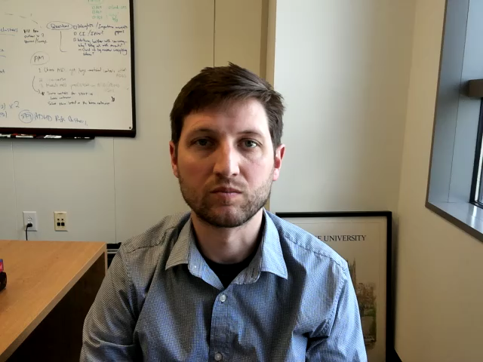
Deep CNNs
Matthew Engelhard
Many slides created by Tim Dunn
Notes:
Hi Everyone
In this lecture, we’ll continue to explore the idea that CNNs create a hierarchy of image features
Specifically, we’ll discuss how the feature maps produced by the filters in each layer of the network
are then used by the next layer to detect even more complex features

Slide 2
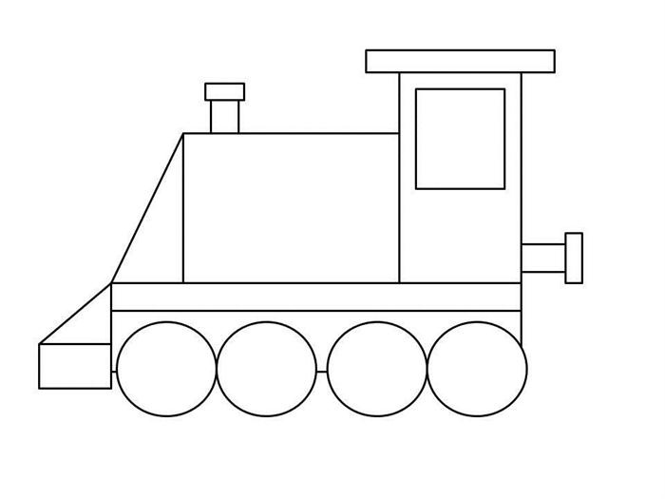
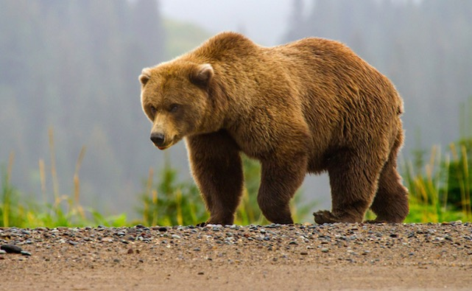
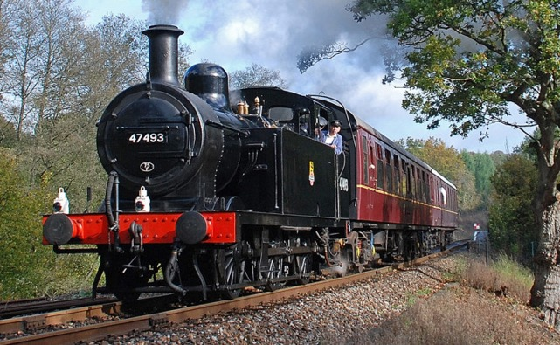
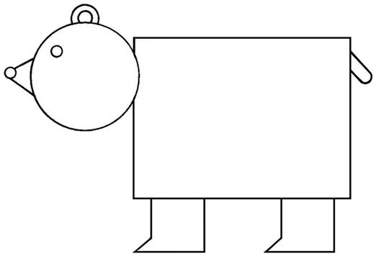

CNNs Take Advantage of Repeated, Hierarchical Structure in Images
Notes:
Last time, I argued that even though the bear and train are quite different, the fundamental building blocks are similar: both are composed of lines, textures, simple shapes, and so on

Slide 3
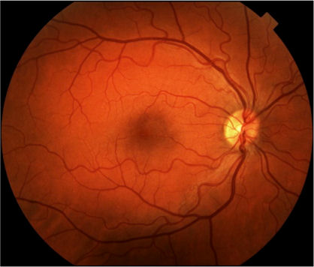
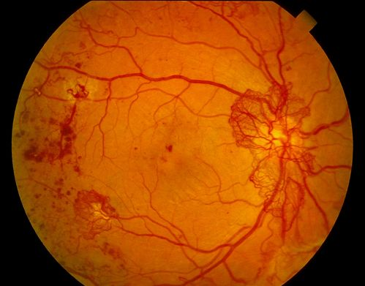

Deep Learning for Image Analysis
Diabetic Retinopathy Classification
Healthy Retina
Unhealthy Retina
Notes:
Similarly, although the images here look very different on a high level, again, the higher-level features of interest – exudates, hemorrhages, etc – are composed of much simpler features common to both images
Indeed, these low-level features are common to all naturalistic images – in other words, images captured with some kind of camera
It turns out that for this reason, much of what we learn from classifying bears and trains – specifically, how to identify low-level features like lines and textures – ends up helping us when we want to sense of medical images as well
We’ll come back to this idea, which we call transfer learning, in our medical image analysis lectures

Slide 4

Consider a Set of “Toy” Images,
for illustration of how this structure can be extracted by an algorithm
Notes:
Let’s go over the idea again – the idea that images contain a hierarchy of increasingly complex features -- using one more example
Here we’ll consider a set of toy images, each of which contains several complex motifs, or patterns, that we’d like to be able to identify
It may be helpful to imagine that these motifs are biologically relevant – for example, they could be different types of cells we’d like to identify
In the leftmost image, there are four of these high-level motifs, one in each corner
Let’s work through how our CNN would identify them

Slide 5
High-Level Motifs/Structure
Notes:
Here we can take a look at all the different motifs that may be present in the images
Note that these motifs can occur anywhere in any of the images
Again, one of these might be a red blood cell, another could be a macrophage, and so on

Slide 6
Shared Substructure Within Motifs
Notes:
Even though our motifs are all very different, we see that there are a number of submotifs that are common to several of them
The submotif highlighted here – two diamonds next to two circles – appears in 5 of the motifs
We might think of this as an organelle that appears in some cell types but not others

Slide 7
Shared Substructure Within Motifs
Notes:
Here’s another submotif, composed of four rounded rectangles in a particular arrangement
It appears in 3 of the motifs

Slide 8
Shared Substructure Within Motifs
Notes:
And here’s another one, a submotif compsed of a circle, triangle, and rectange – it appears on three of the motifs

Slide 9
Shared Substructure Within Motifs
Notes:
Here’s one more submotif

Slide 10
Hierarchical Representation of Images
Layer 3:
Motifs
Layer 2:
Sub-Motifs
Layer 1:
Fundamental Building Blocks
Notes:
If we go through all of our motifs very closely, we can see that there are 7 sub-motifs in total
Our motifs are composed entirely of these submotifs
Going back to our biological example, we might suppose that each cell type is composed of a common number of components, and that a given cell type can be recognized by which components are present, and it what arrangement.
And of course our submotifs are themselves composed of a number of shapes
We have triangles, circles, diamonds, and so on
These are our lowest level features – they’re the fundamental building blocks of our images
We now have a hierarchy with 3 levels, each one built on top of the last
We have shapes, our building blocks
We have submotifs, composed of a small number of shapes in a particular arrangement
And we have motifs, composed of a small number of submotifs in a particular arrangement
In our biological example, the lowest level features might be very simple contours and textures
The next level would be organelles
And the highest level would be the cell type
We want to have a model that first identifies the building blocks, then identifies the submotifs based on those building blocks, and then identifies the motifs based on the submotifs
This is what we mean by a hierarchy of features

Slide 11
Recall the Data/Images
Notes:
Let’s go back to our images – remember, we want to determine which motif(s) are present in a given image

Slide 12
Convolutional Filter
Notes:
Let’s see how we can use our feature hierarchy to detect motifs in this first image
First, we’ll apply filters that are looking for our lowest-level features – our building blocks. Each one is looking for a particular shape
Here we have a filter that’s looking for triangles

Slide 13
Convolutional Filter
Notes:
We apply the convolution operation – we move this filter across the whole image, just as we did in our previous lecture
And now we get a feature map that will be bright in exactly those locations where triangles are present
This feature map shows us where the triangles are located – it has detected them

Slide 14
Convolutional Filter
Notes:
But we don’t use just one filter – we also have a filter that detects the circles! In fact, we have one filter for each of the building blocks we’d like to identify
The circle filter will give us another feature map, and this one will show us the locations of all the circles in the image

Slide 15
Multiple Filters, One for Each Building Block
Input Image
Filters
Notes:
We have 7 filters in total, and we convolve each one with our image

Slide 16
Feature “Maps”
Input Image
Filters
Notes:
As a result, we get 7 feature maps, one corresponding to each filter
We can stack them up, in order

Slide 17
Feature “Maps”
Layer-2 Filters
Input Image
Filters
Notes:
Now, and here’s the key: we want to use these feature maps to identify our submotifs
We’ll have a single filter for each submotifs, but these filters won’t be applied to the original image:
They’ll be applied to the feature maps that we just created
This second round of filters – we’ll call them layer-2 of our model – they’ll need to have a length and width, just like the previous filters, but also a depth corresponding to the number of feature maps
Let’s think about a layer 2 filter that’s looking for the submotif pictured here, toward the top right
It’s looking for a square with a circle to its right, and then a triangle below that
The locations of the squares are shown in feature map 1; the circles in feature map 2; and the right triangles in feature map 6
So our filter is looking for a bright spot in feature map 1 that’s just to the left of a bright spot in feature map 2; both of which are just above a bright spot in feature map 6
Remember that our filters find patterns that look like them, so this layer 2 filter will need to look like that pattern I just described

Slide 18
Feature “Maps”
Layer-2 Filters
Input Image
Filters
Notes:
We have 7 submotifs to identify in total. The filter to identify this submotif will be looking for a rounded rectangle above a triangle, next to a circle
The locations of the rectangles are indicated by feature map 4; the circles by feature map 2, and the non-right triangles by feature map 3
So this filter is looking for bright spots in those 3 feature maps, in close spatial proximity to one another

Slide 19
Layer 1
Feature “Maps”
Layer-2 Filters
Input Image
Layer-1 Filters
Notes:
So far our model has two layers:
In layer 1, we created feature maps for each of our shapes
In layer 2, we used those feature maps to find the locations of each submotif using layer-2 filters
Each of those layer 2 filters will give us a feature map telling us the locations of the respective submotifs

Slide 20
Layer 2
Feature “Maps”
Layer 1
Feature “Maps”
Layer-2 Filters
Input Image
Layer-1 Filters
Notes:
We get 7 layer 2 feature maps in total, one corresponding to each submotif
We can stack them all up, in order

Slide 21
Layer 2
Feature “Maps”
Layer-3 Filters
Layer 1
Feature “Maps”
Layer-2 Filters
Input Image
Layer-1 Filters
Notes:
And now, finally, we have what we need to identify our motifs
One of our motifs, the one shown here, is composed of the first, fifth, and seventh submotif
We can identify this motif with a filter that’s looking for bright spots in first, fifth, and seventh layer-2 feature maps; in close proximity with one another

Slide 22
Layer 3
Feature “Maps”
Layer 2
Feature “Maps”
Layer-3 Filters
Layer 1
Feature “Maps”
Layer-2 Filters
Input Image
Layer-1 Filters
Notes:
We need one filter like this – one layer 3 filter – for each of our motifs
Each filter tells us the locations of that motif within the image
We can stack up all these layer 3 feature maps
Now we have exactly what we need to solve the original problem of identifying our motifs
We have feature maps that tell us exactly where, in the image, each of the motifs is located
Some of them won’t be located anywhere – this is useful for us to know
And we did this not by directly identifying the motifs in the image, but rather by first identifying simple features, then more complex ones, and so on – we identified the increasingly complex features that our motifs are composed of
This allowed us to take advantage of shared substructure in the images

Slide 23
Deep CNN Architecture
Layer 3
Feature “Maps”
Classifier
Layer 2
Feature “Maps”
Layer-3 Filters
Layer 1
Feature “Maps”
Layer-2 Filters
Input Image
Layer-1 Filters
Notes:
Now we can ask: was motif 1 present anywhere in the image?
Let’s check our first layer 3 feature map to see – wherever it’s bright, that’s where motif 1 is present
If it’s bright anywhere, then motif 1 is present; otherwise it is absent
Some high level feature maps might tell us where eosinophils are located, others where T cells are located
In a model for retinopathy, some might tell us the locations of hemorrhages, others about exudates, others about normal-appearing vessels
Once we have our feature maps, we only need a very simple model to then make predictions about which features are versus aren’t present – at this point, we only need a single, logistic regression layer

Slide 24
Advantage of Hierarchical Features?
By learning and sharing statistical similarities
within high-level motifs, we better leverage
all training data
If we do not use such a hierarchy, top-level
motifs would be learned in isolation of
each other
Layer 3:
Layer 2:
Layer 1
Notes:
Again, what’s the advantage of this hierarchical approach?
Without it, we’d need an unthinkable number of extremely complex filters for each of the objects we’d like to identify
With it, we take advantage of shared structure among objects, which helps us to learn more effectively, and also allows us to have models that use orders of magnitude fewer parameters
This is critical to make learning possible – the problem would otherwise be too complex.

Slide 25
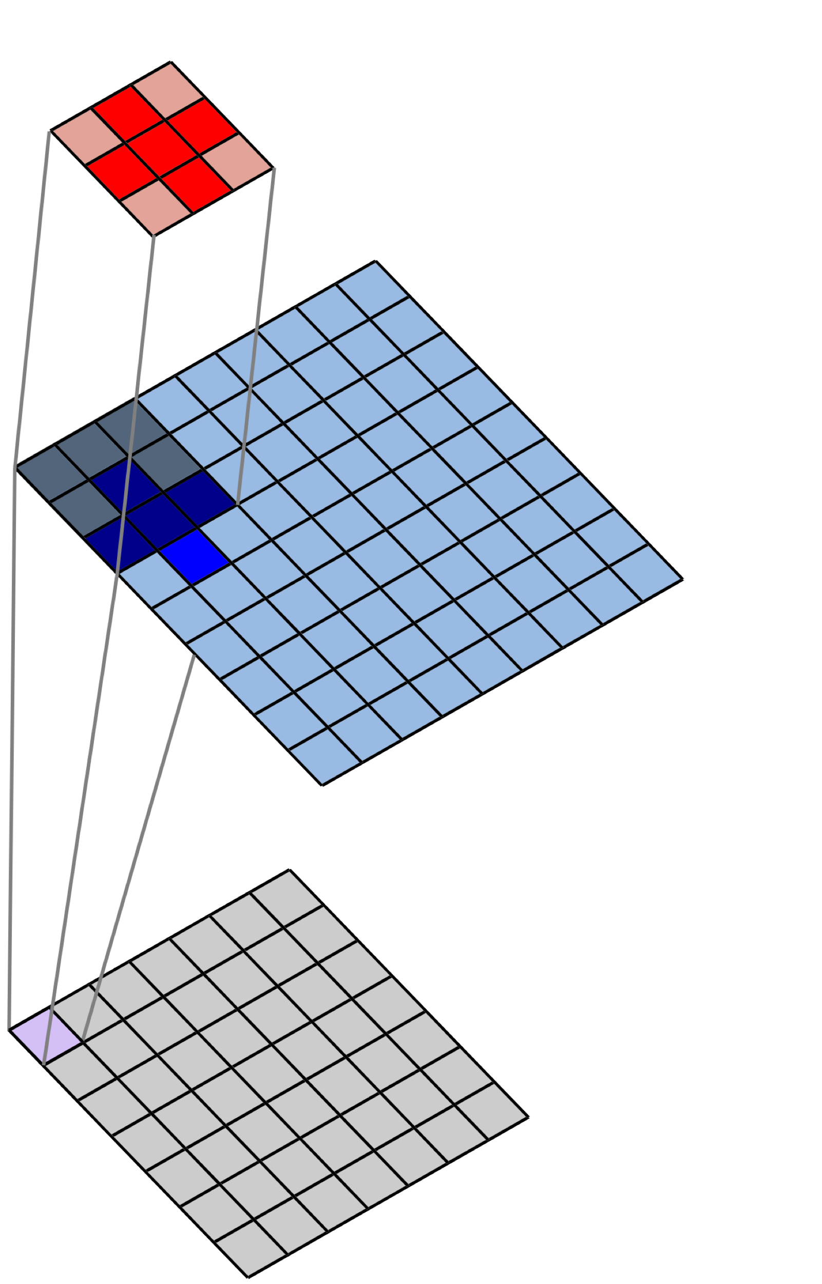
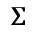

2D Spatial Convolution
Filter
$$×$$
Image
$$Σ$$
Convolved Image
(Feature Map)
Notes:
Let’s go back to our 2D convolution visualization from before

Slide 26
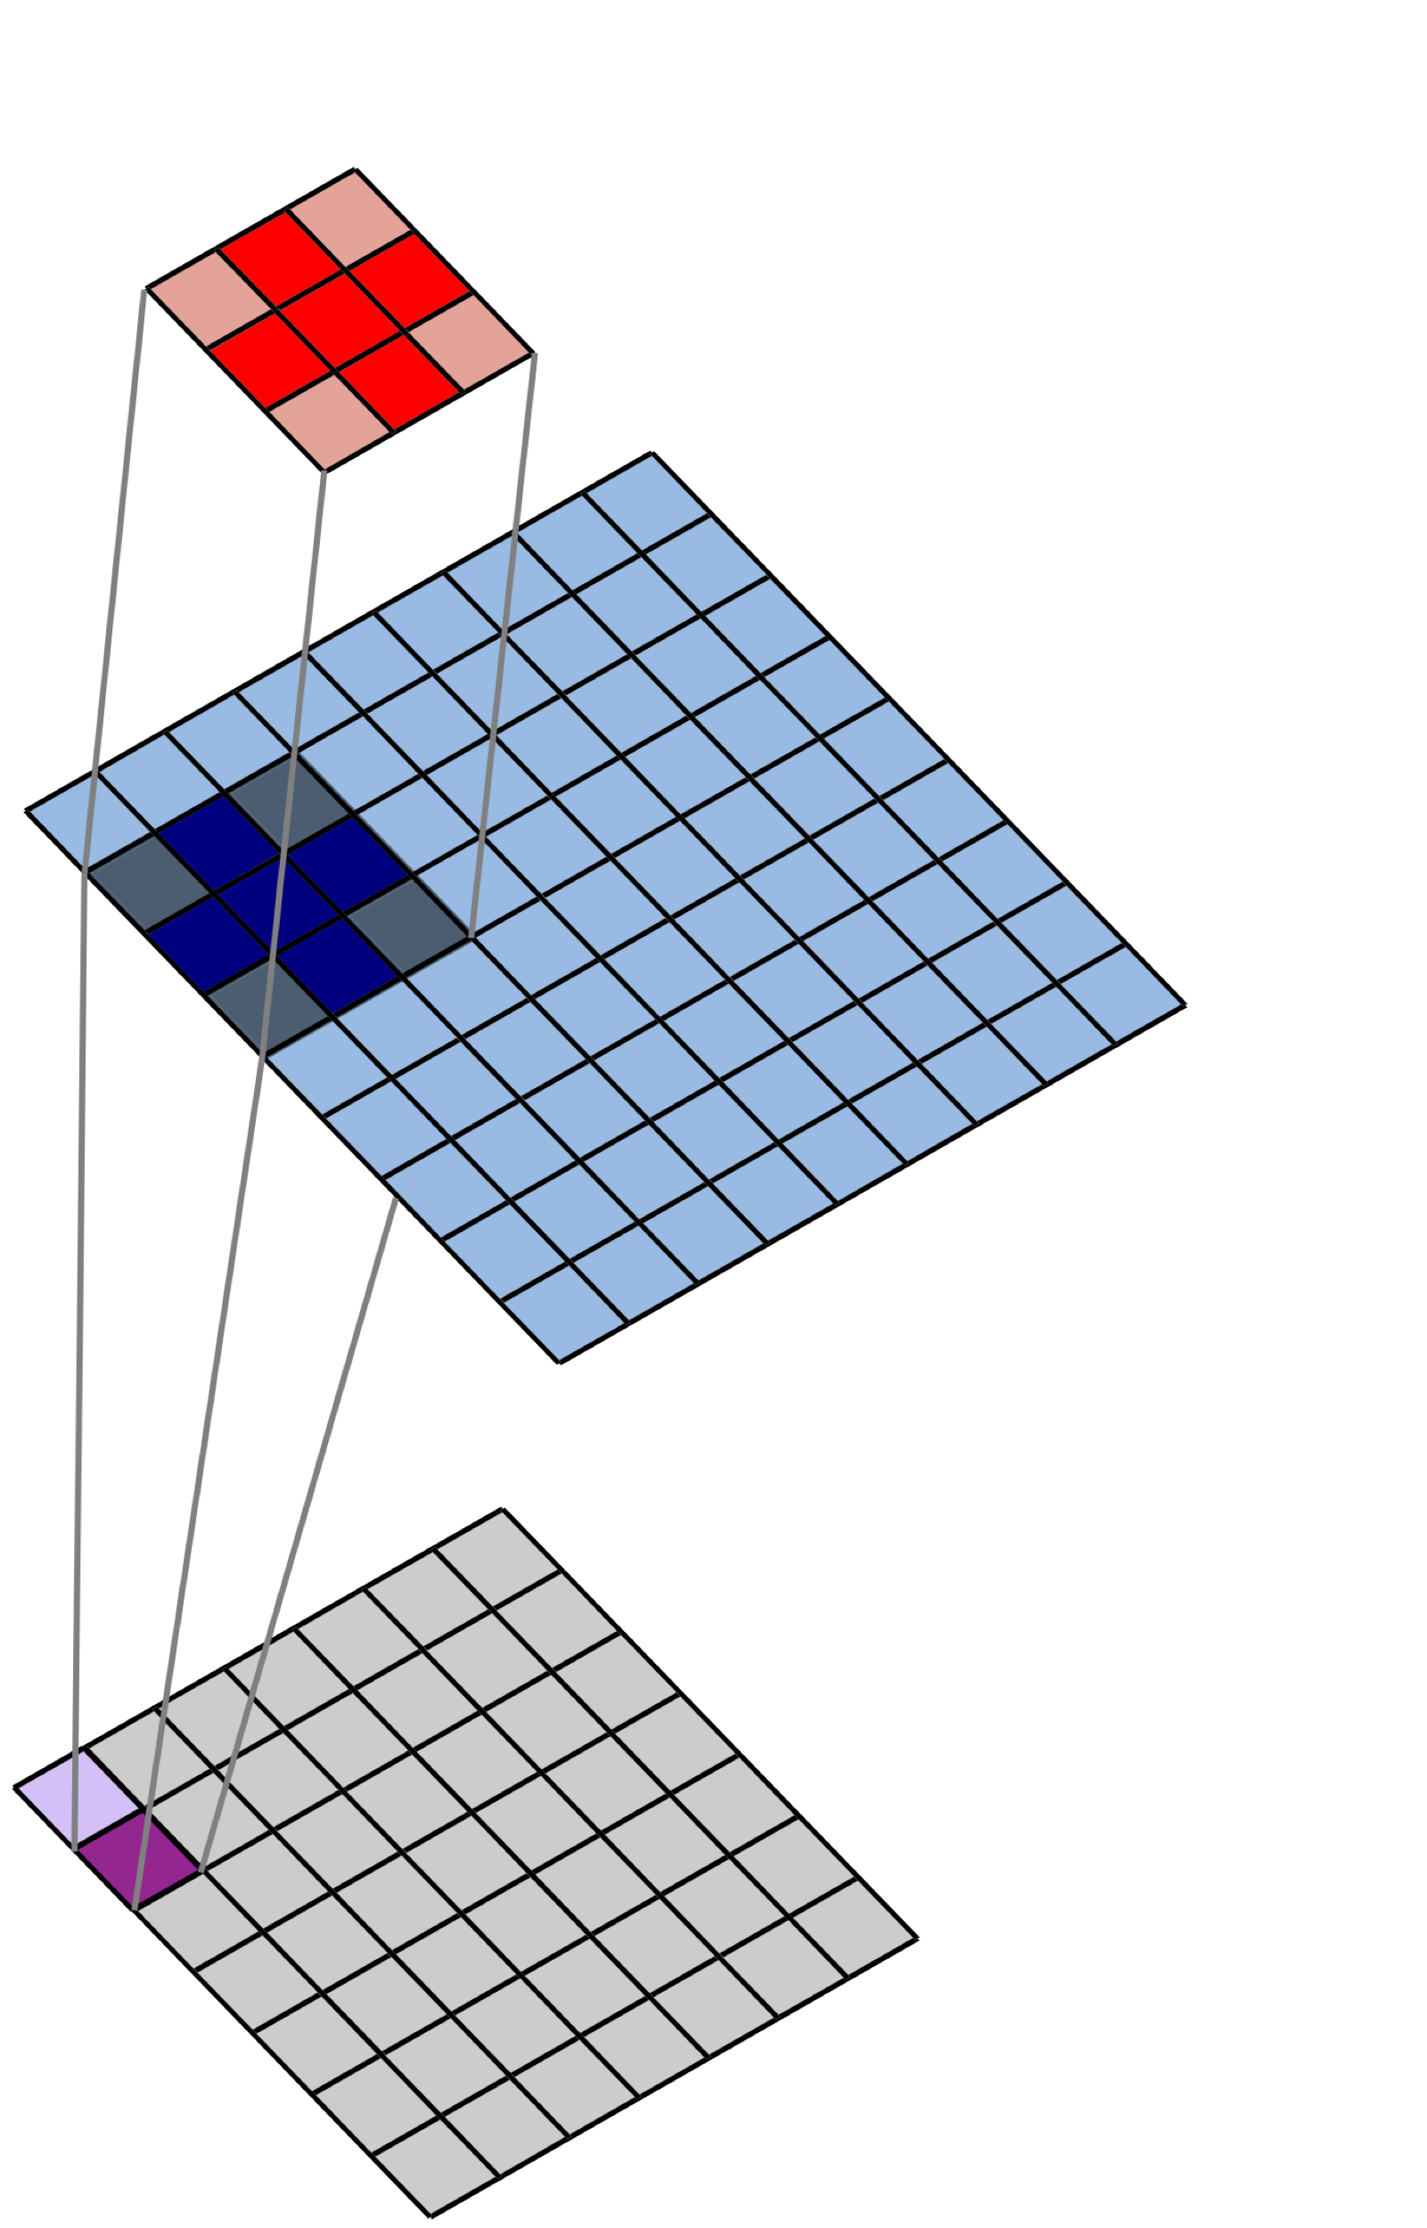
2D Spatial Convolution
Filter
$$×$$
Image
$$Σ$$
Convolved Image
(Feature Map)
Notes:
Here again we have a simple filter that we move across our input image – we’re convolving the filter with the image

Slide 27
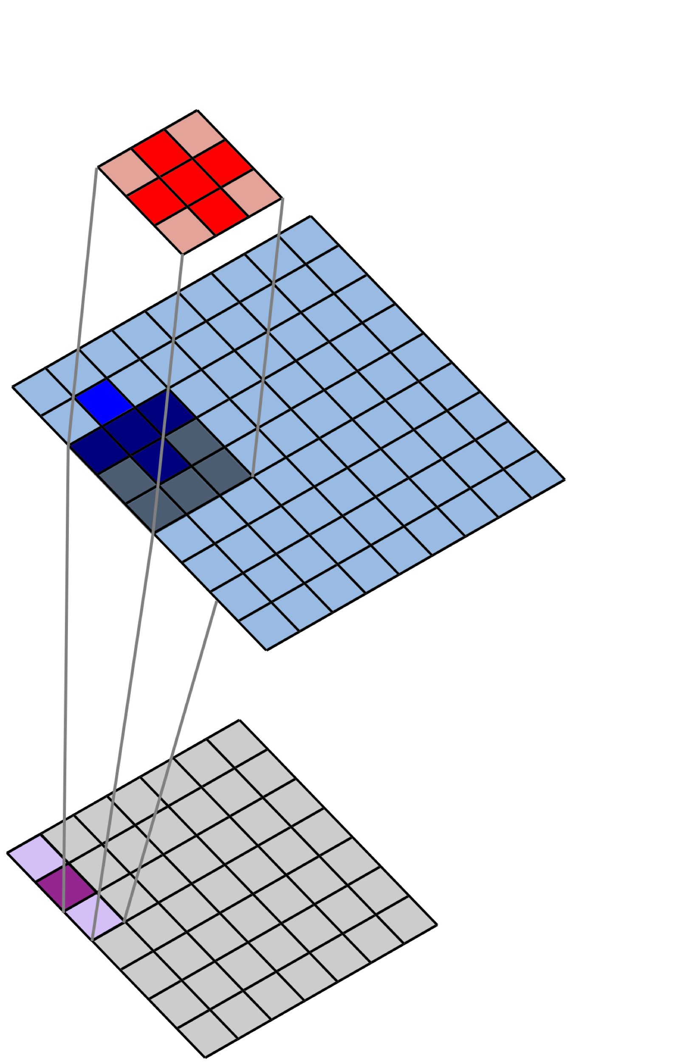
2D Spatial Convolution
Filter
$$×$$
Image
$$Σ$$
Convolved Image
(Feature Map)
Notes:
The resulting feature map will tell us where the crosses are located in the image

Slide 28
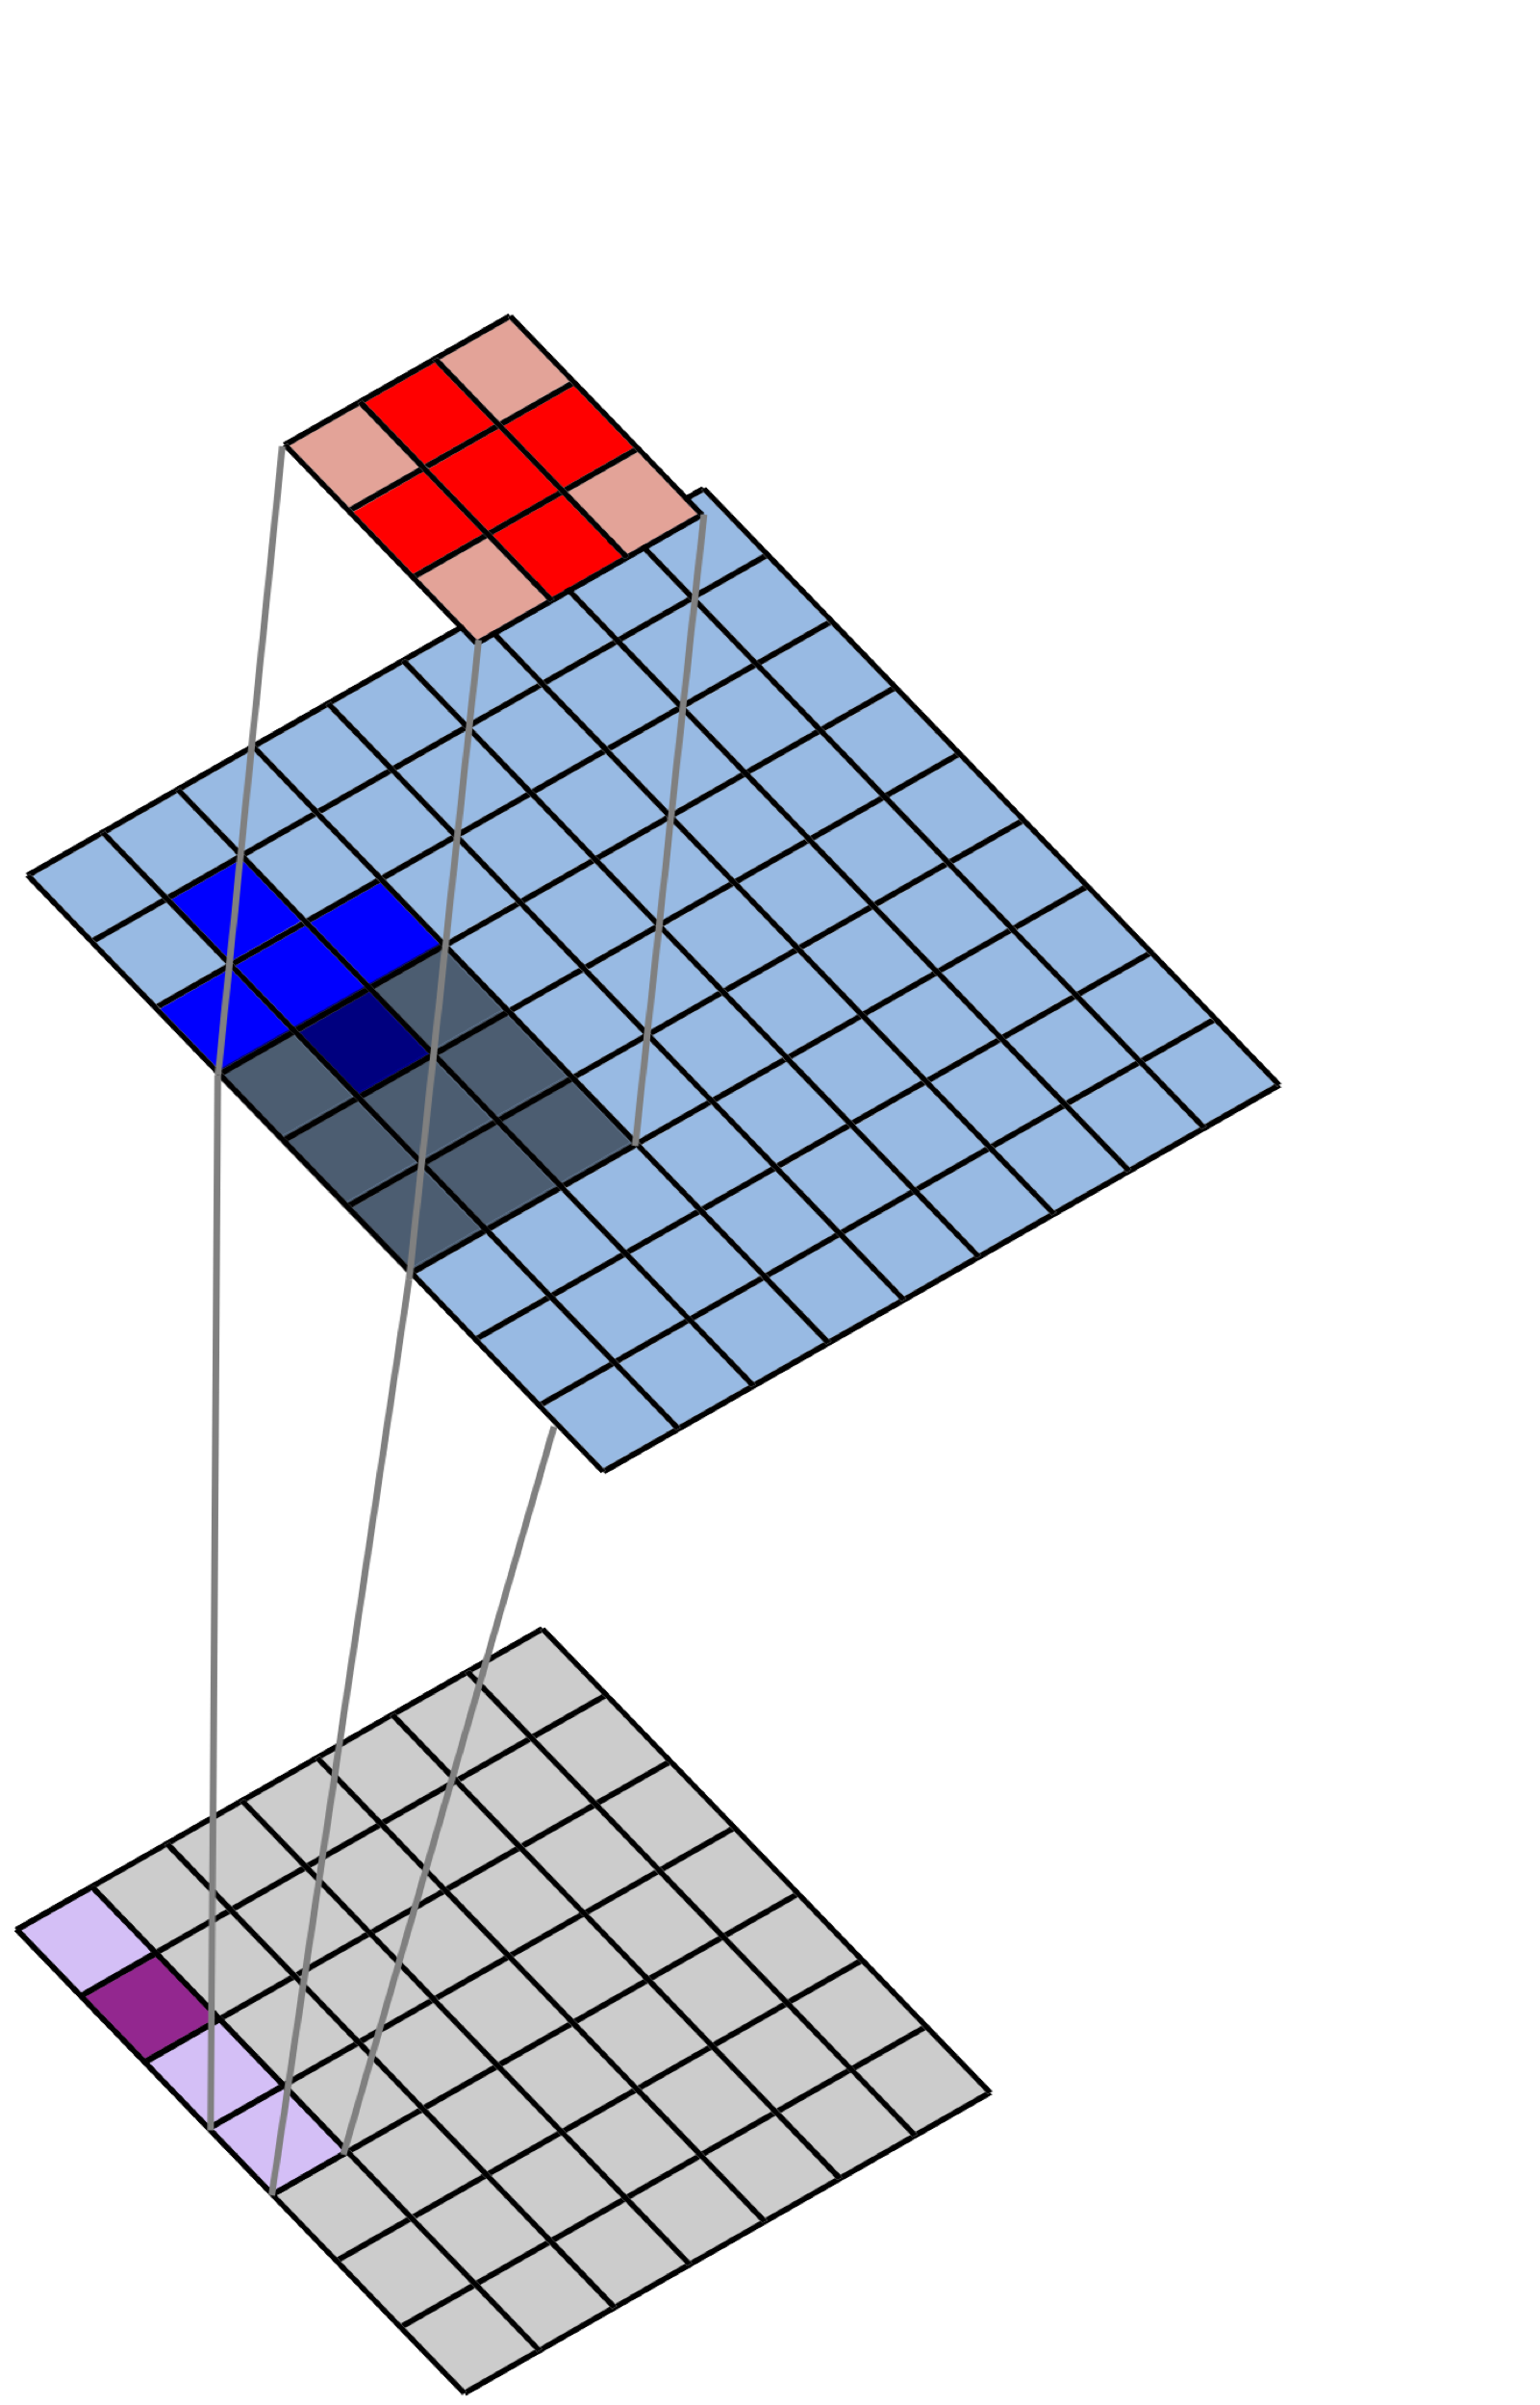
2D Spatial Convolution
Filter
$$×$$
Image
$$Σ$$
Convolved Image
(Feature Map)
Notes:
Here we’re just moving down the first column of the image

Slide 29
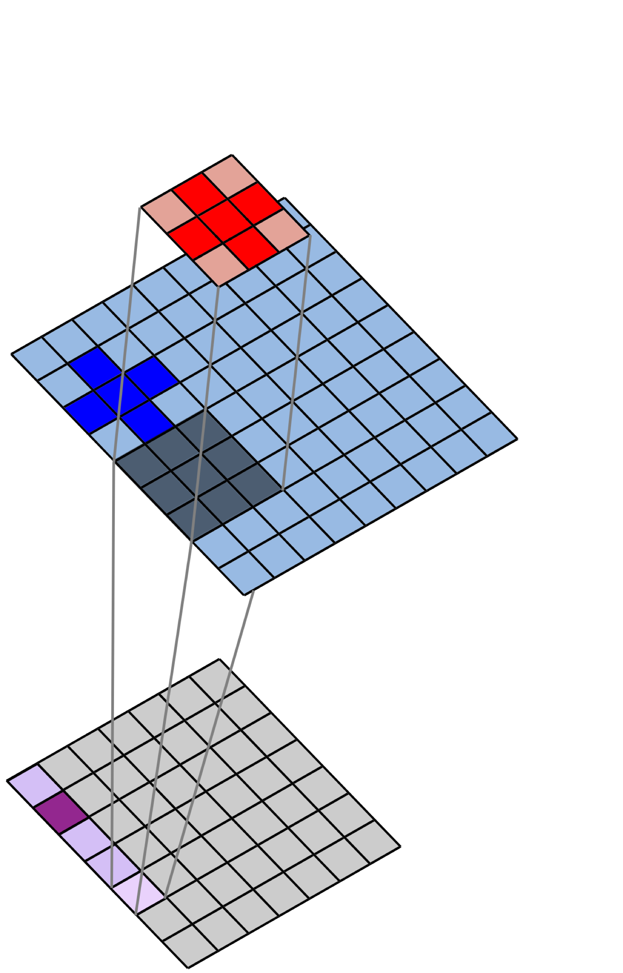
2D Spatial Convolution
Filter
$$×$$
Image
$$Σ$$
Convolved Image
(Feature Map)
Notes:
But we’d do this for the entire image

Slide 30
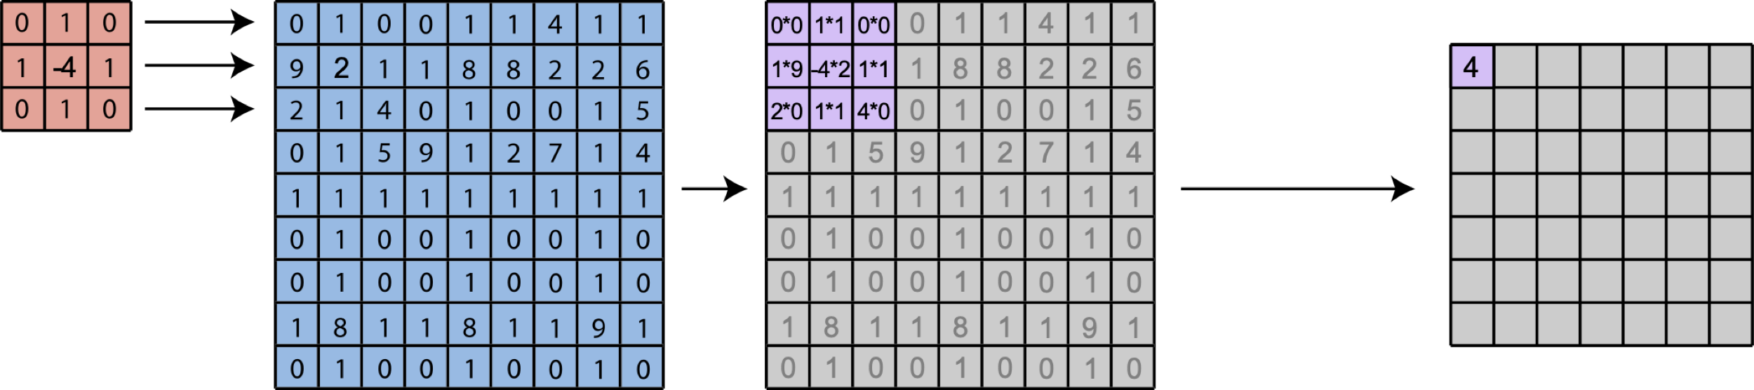
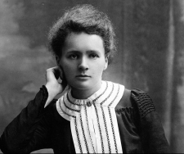
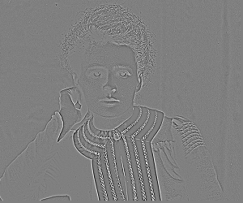
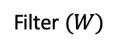
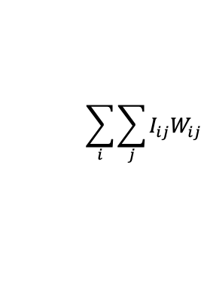
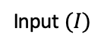
2D Spatial Convolution
Filter $(W)$
Input $(I)$
$$\sum_{i}{\sum_{j}{I_{ij}W_{ij}}}$$
Notes:
We’ve seen some examples of simple filters that identify shapes – circles and triangles
Here’s a filter that is quite useful in practice – it allows us to identify edges in our image
When we convolve this “edge detector” with the image shown, we get a feature map that shows us everywhere where a sharp edge is present

Slide 31
Filters Operate Over Input Volumes
Feature “Maps”
Layer-2 Filters
Input Image
Filters
Notes:
But in most layers of our model – all but the first one – our filters will be applied to a stack of feature maps rather than an image

Slide 32
Filters Operate Over Input Volumes
Feature “Maps”
Layer-2 Filters
Input Image
Filters
Notes:
As a result, as mentioned before, our filters will have 3 dimensions – 2 spatial dimensions and an additional depth corresponding to the number of feature maps in that layer
Moreover, if we’re working with color images, then are images themselves are actually volumes – usually there’s a red, green, and blue channel.
When working with black and white images, our layer-1 filters have depth of 1 – they’re 2D – but when working with color images, our layer-1 filters will have a depth of 3 corresponding to these 3 channels

Slide 33
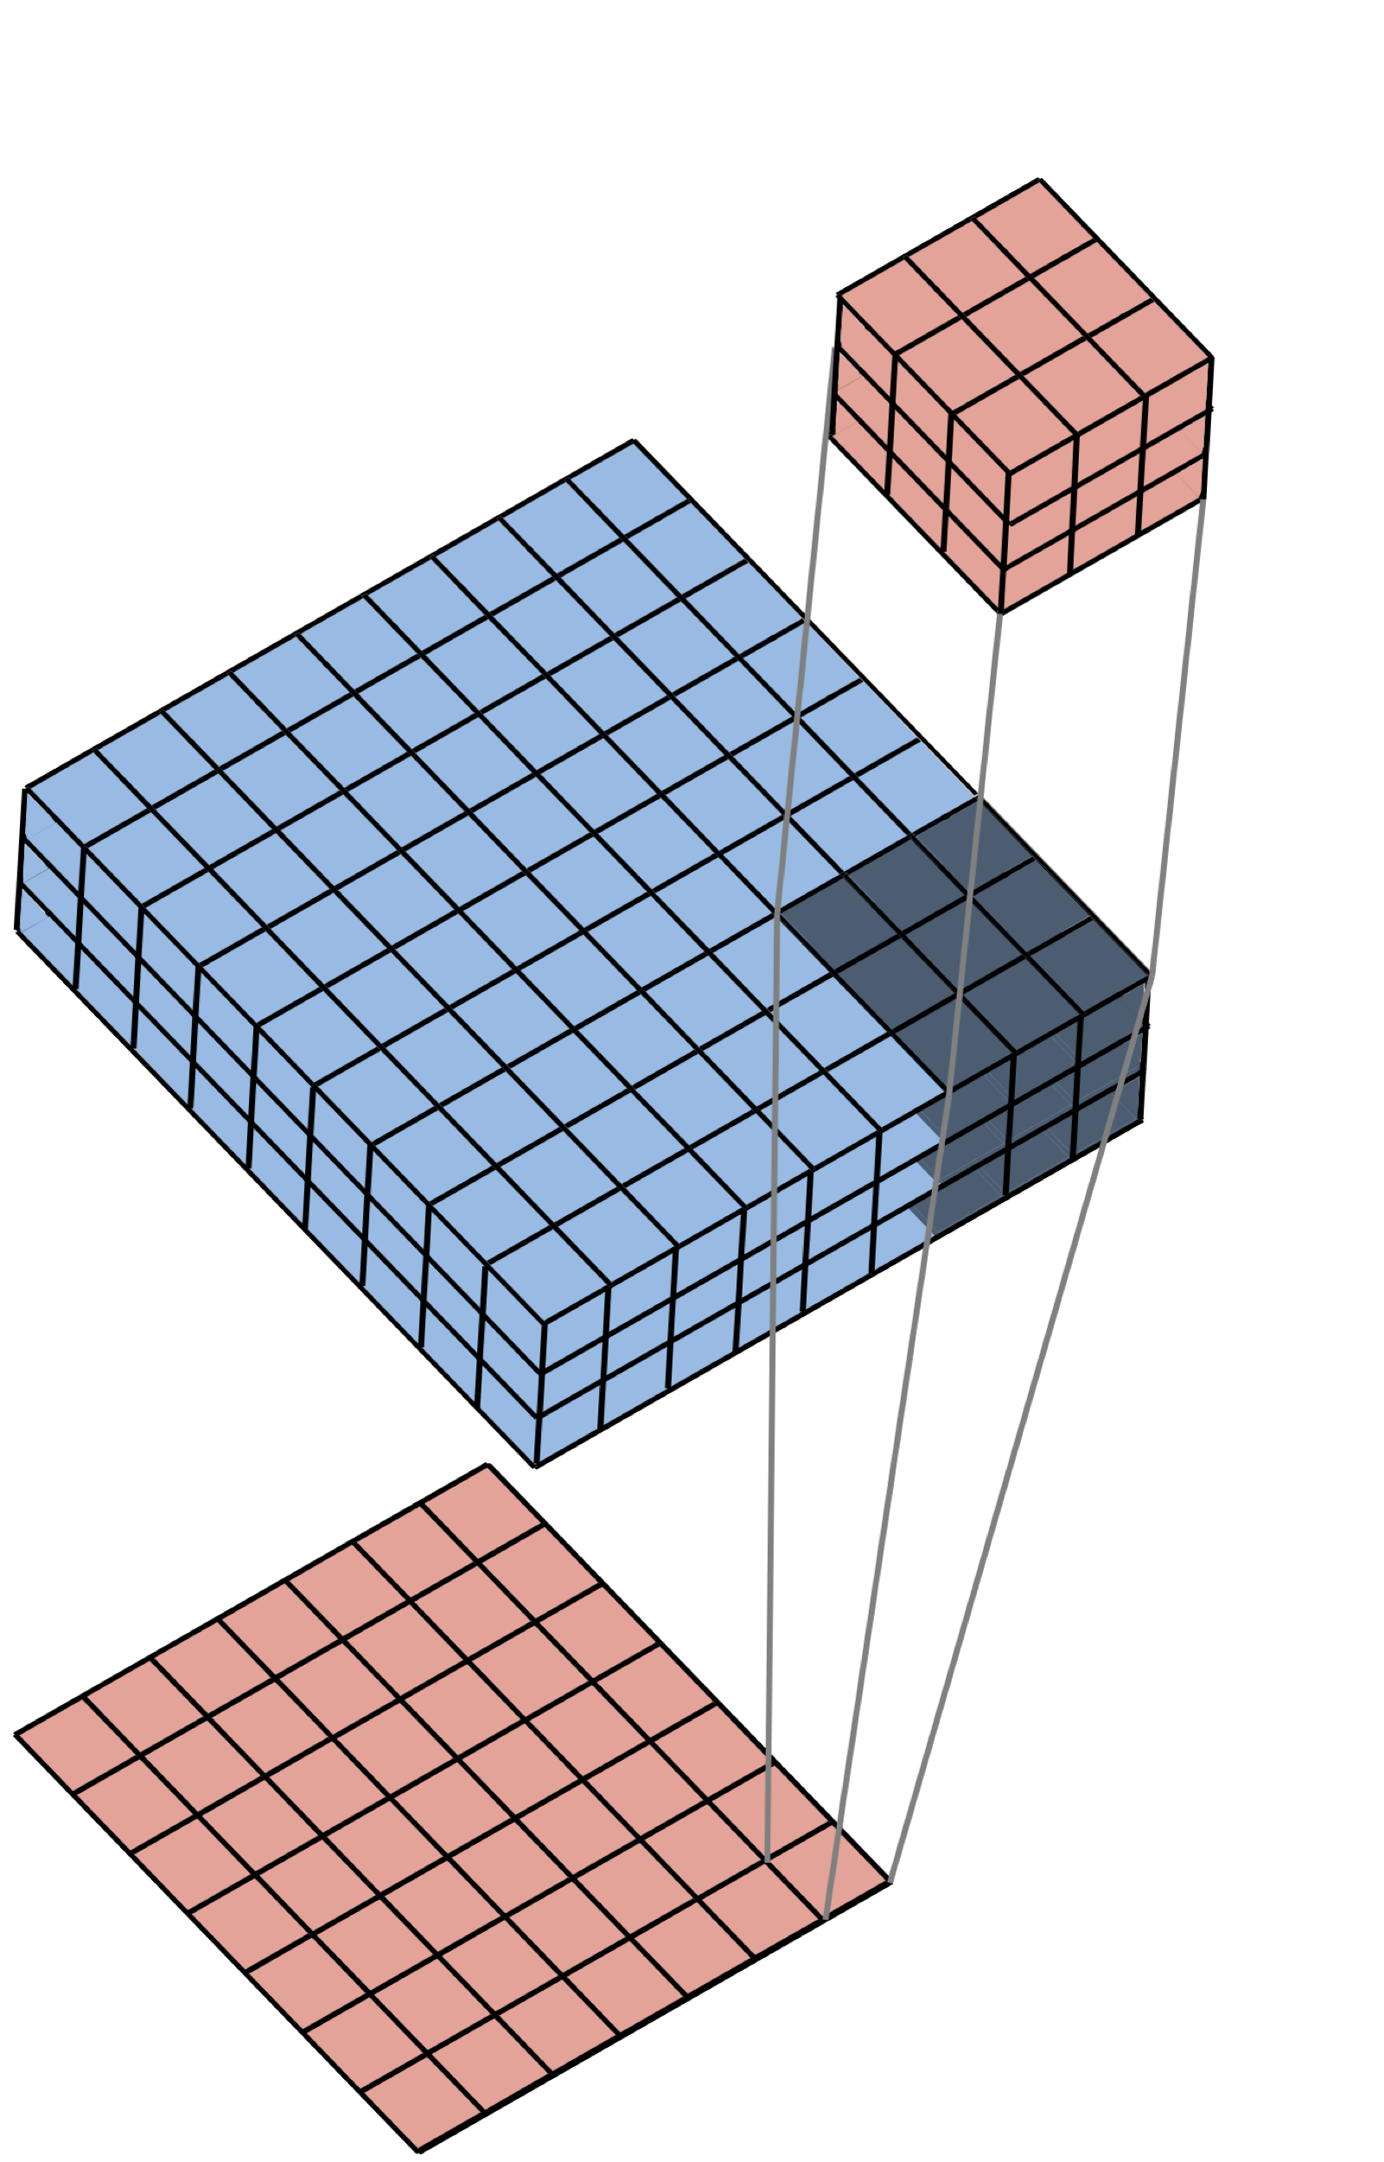
Filters Operate Over Input Volumes
Filter (3x3x3)
Image (9x9x3)
Feature Map (7x7x1)
Notes:
When our filters are 3 dimensional, the picture becomes slightly different – we still move the filter across our two spatial dimensions, but again, there is depth to both the filter and the image. Each feature map, on the other hand, will always have a depth of 1 – it is simply bright in the spatial locations in our image that look like the filter, and dark everywhere else.

Slide 34
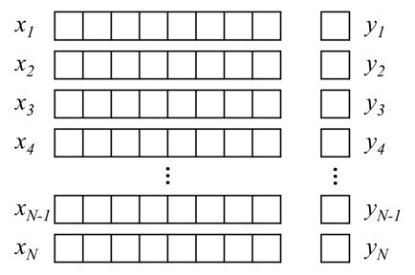
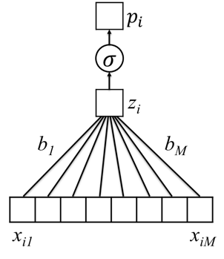
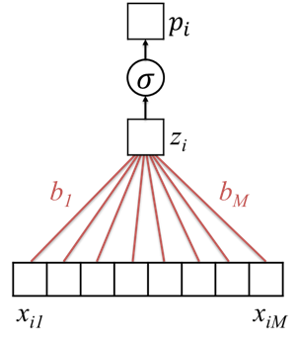
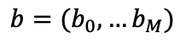
Given Labeled Training Images, How do we Learn the Parameters of the CNN?
Training Set
$$p_{i}=σ(b_{0}+b_{1}x_{i1}+b_{2}x_{i2}+…+b_{M}x_{iM})$$
$b=(b_{0},…b_{M})$
Untrained Logistic Regression
Model (or “Network”)
Trained Model (with learned parameters)
Notes:
Now, from our earlier lectures that the learning process involves combining a training dataset with an untrained model
We decide that we want to model our data using logistic regression, and then we use stochastic gradient descent to find specific model parameters that are matched to that training data
We then fix those parameters, and we can use our model to make predictions for data we haven’t seen before

Slide 35
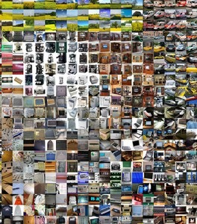
Given Labeled Training Images, How do we Learn the Parameters of the CNN?
CNN
Architecture
Trained
CNN
Notes:
All of this is true for the CNN as well
In this case, the training set is a large number of labeled images
Our model, the CNN, is what we’ve described in this lecture – multiple rounds of convolutional filters that extract a hierarchy of image features
We put those things together -- the data and the model -- by applying stochastic gradient descent to minimize the cross-entropy loss between the true labels and the labels predicted by the model
Now we have a trained CNN that can be used to make predictions about data it hasn’t yet seen before
If the training set contains images of dogs and cats, our trained CNN will be able to make predictions about whether a new image contains either a dog or a cat
If the training set contains images of cancerous and benign skin lesions, our trained CNN will be able to make predictions about whether previously unseen lesions are cancerous or benign

Slide 36
Architecture (specified) vs Parameters (learned)
Architecture:
Number of layers
Layer types (e.g. convolutional, pooling, fully connected)
Number of filters in each layer
Shape and size of filters
Use 3x3 filters
In layer 1
Parameters:
Individual Elements of each filter
Parameters of other layers
Learn values of
Each layer 1 filter
-1 | 1 | -1
1 | -1 | 1
-1 | 1 | -1
Notes:
Now, what are the parameters of our model?
They’re all of the individual values of our filters
In this lecture, we’ve given many examples of filters
But the filters in our model will in fact be learned from the data! Just like our previous model learned a filter that allowed it to distinguish ones from zeros, our CNN will learn the hierarchy of features all on its own, from the data
We decide how many filters there will be in each layer, how big they’ll be, and how many layers there will be.
And then, through the learning process, the model will tune its filters to allow it to make effective predictions
For complex problems, where we wish to identify highly complex features, many layers of filters will be required – in other words, we’ll need a DEEP CNN
These models contain a very large number of parameters – millions and in some cases even billions – so it is not surprising that a very large dataset, often millions of images, is required.
In later lectures, we’ll talk about how we can get around this requirement to make good predictions on medical image processing tasks for which we have thousands, not millions, of labeled images available to us

Slide 37
Summary
Convolutional neural networks learn to recognize high-level structure in images by building hierarchical representations of features
Features are extracted via spatial convolutions with filters
Filters are learned by minimizing a loss function just like in the other models we’ve discussed
Convolutional neural networks have shown capabilities beyond human performance for image analysis

